Slide 1
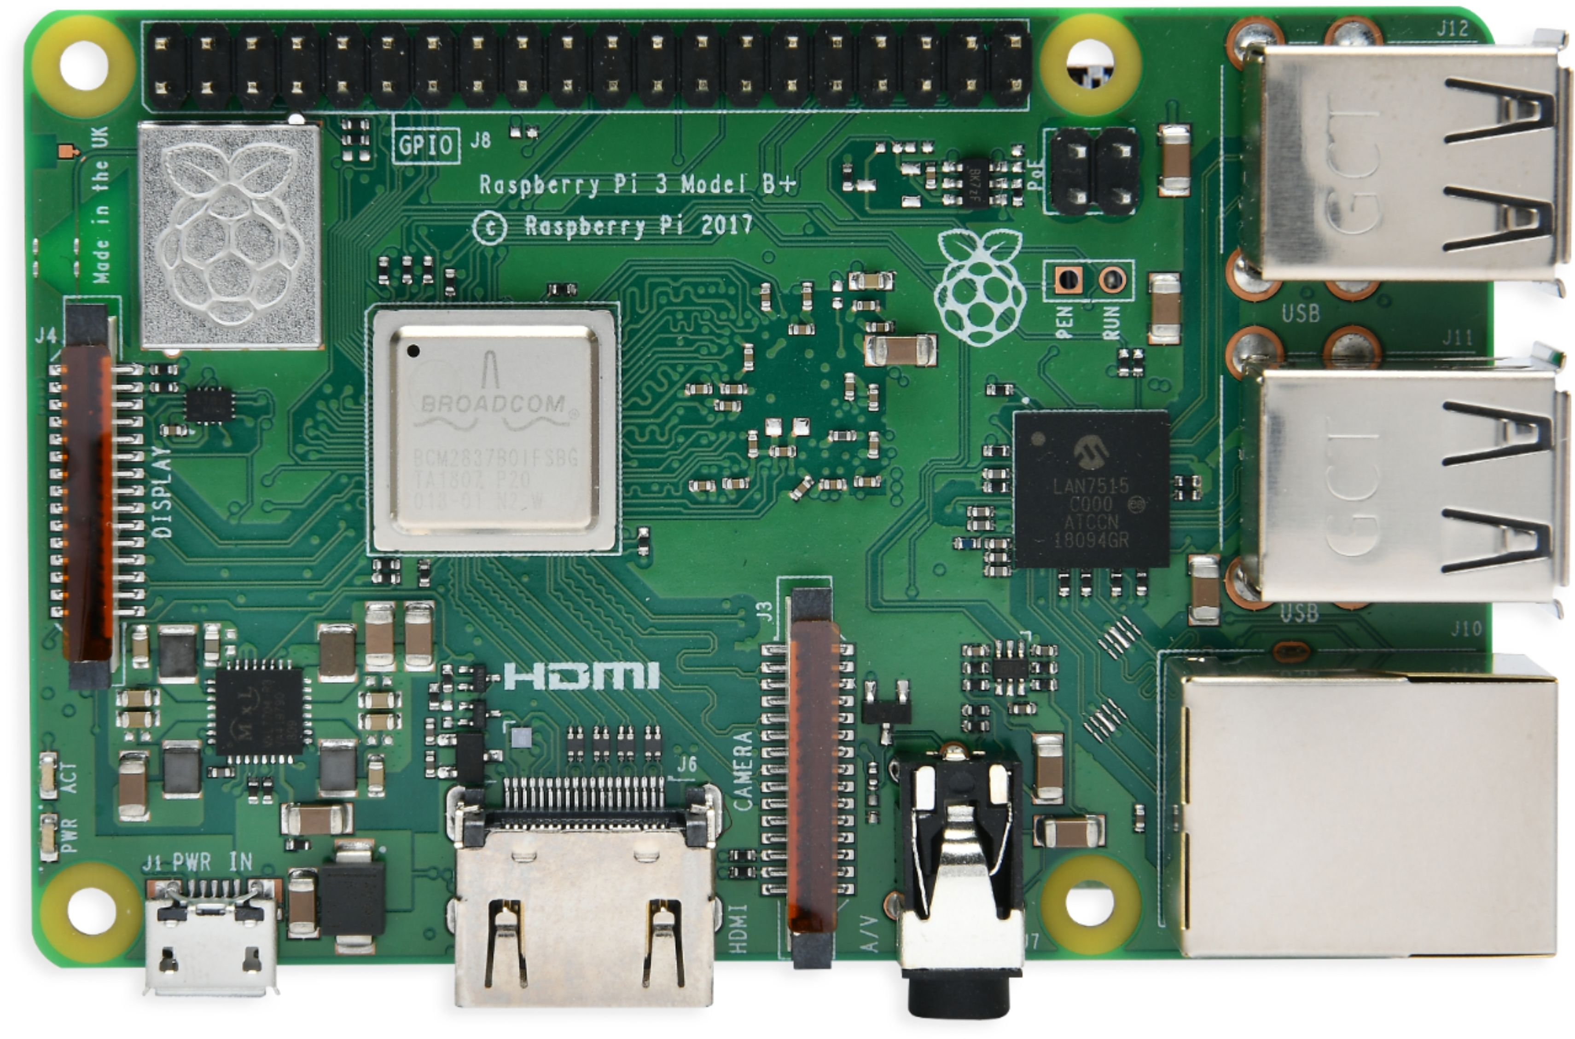
VTOL UAS Operating in GPS Denied Environment
Nicholas Darden, Vivian Fakharizadeh, Zavia Harris, Richard Jones, Trent Jones, Joshua Lee, Ryan McLaughlin, Rushal Patel, Brendan Regan, Quinton Vehon

Slide 2
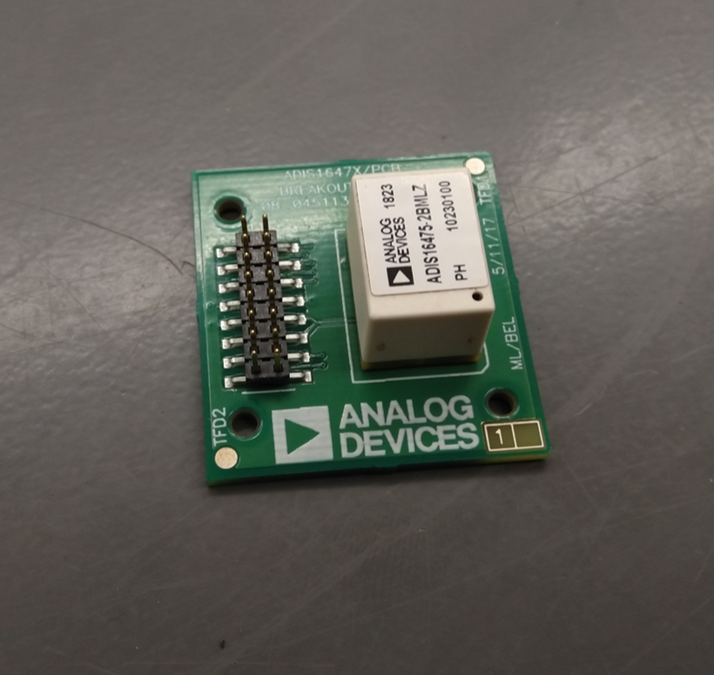
Inertial Measurement Unit

Slide 3
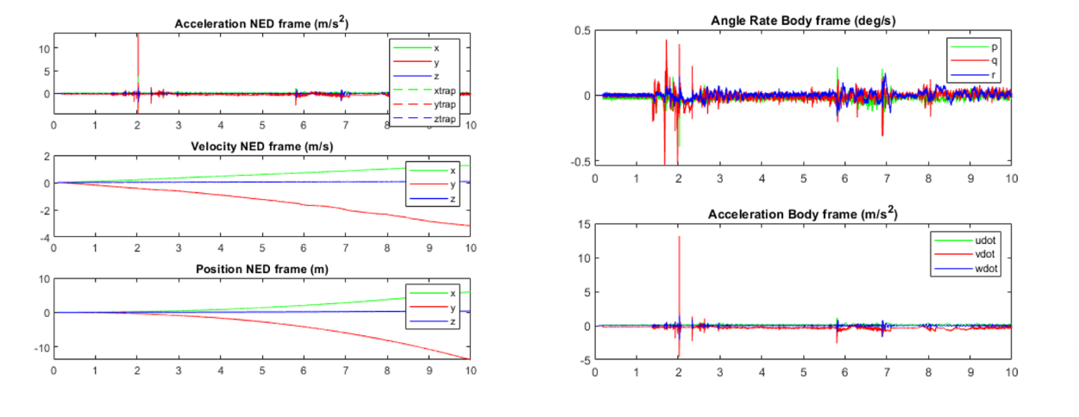
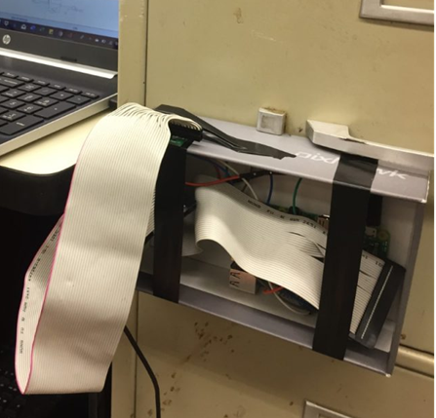
IMU Completed
Dead Reckoning: using a previous location fix to determine current location.
Records measurements taken by accelerometers and gyroscopes.
Velocity, angular rate, acceleration, and position calculated using MATLAB code.
Single Axis Tests- Drawer and Table
Bias recognition
  Implement a subtraction of average bias early in the IMU position code.

Slide 4
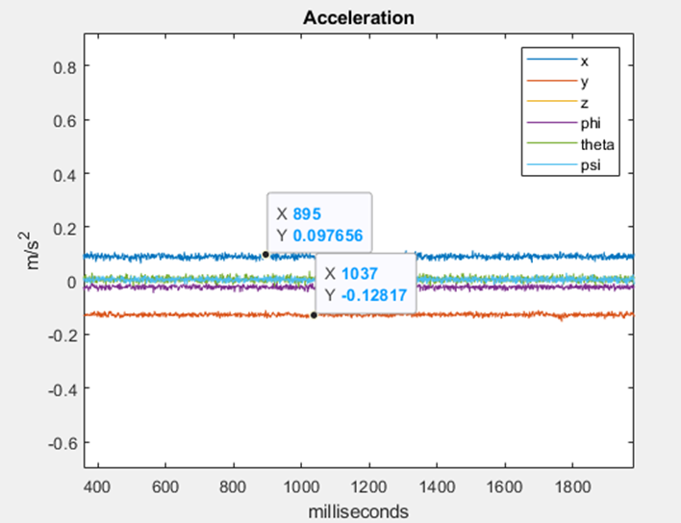
IMU Current Status
Bias Correction:
Averaging the bias
Resulting in 5cm of detected movement
Brainstorming ways to further reduce this error
Challenges:
Inconsistent bias
IMU readings not precise

Slide 5
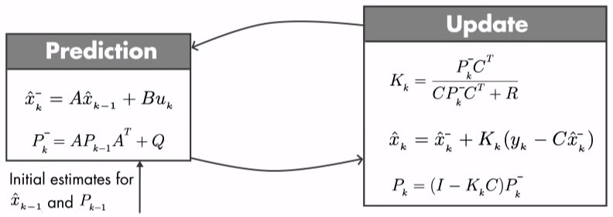
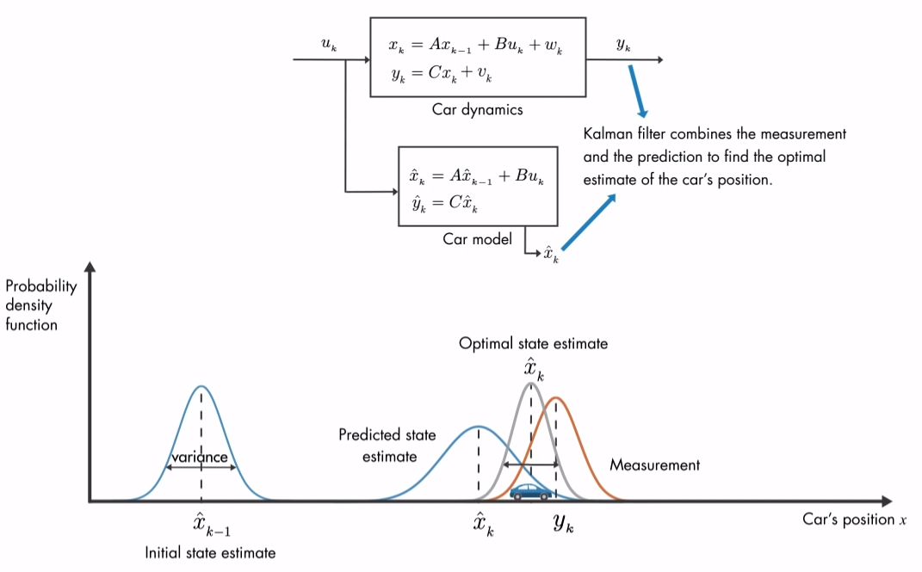
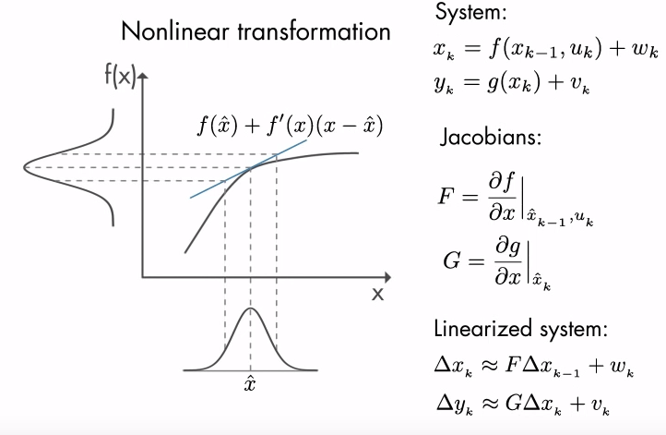
Proposed Methods
Kalman Filter:
Optimal estimation algorithm
Two step process (Predict & Update)
Extended Kalman Filter:

Slide 6
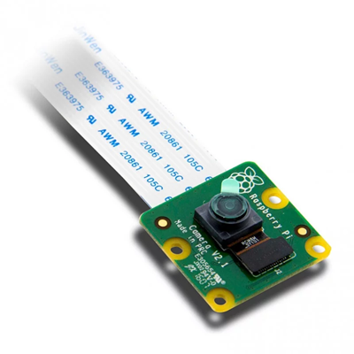
Visual Odometry
Visual identification of custom markers and landing assistance.

Slide 7
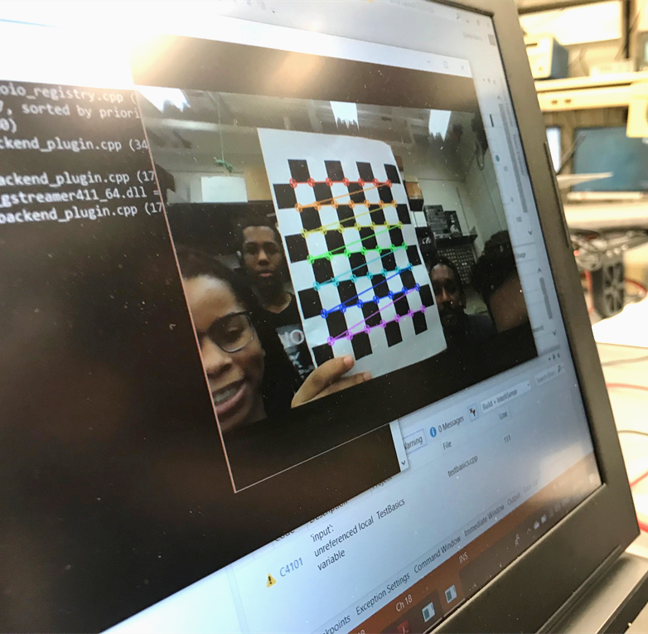
Open CV, ArUco, Camera Calibration
OpenCV:
  open source library of visual tracking functions
  C++ and Python based applications.
ArUco:
  open source library of custom vision identification symbols and functions.
Visual odometry script through Microsoft Visual Studios C++
Calibrated laptop camera to identify and lock onto a checkerboard pattern

Slide 8
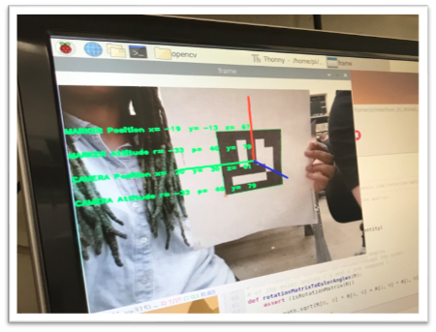
Setting up the Raspberry Pi with ArUco Markers
Currently developing code for communication between Pixhawk and Pi
Tools, dependencies, libraries, and packages to accurately setup ArUco and OpenCV were downloaded
Python code develops and identifies the ArUco markers using Pi camera
Position of the markers for each coordinate relative to the drone can be estimated
Notes:
Currently we are developing code that will allow the pixhawk and raspberry pi to communicate so the raspberry pi can send a signal when the camera locks onto the marker and tells the pixhawk to land on the marker.
To start this process, many tools, dependencies, libraries, and packages to accurately setup ArUco and OpenCV were downloaded onto the raspberry pi.
Based off our research, we developed ArUco marker code in Python instead of C++ previously
So now, on the raspberry pi, we can identify the aruco markers using the code. This will allow code to estimate the position of the markers of each coordinate relative to the drone

Slide 9
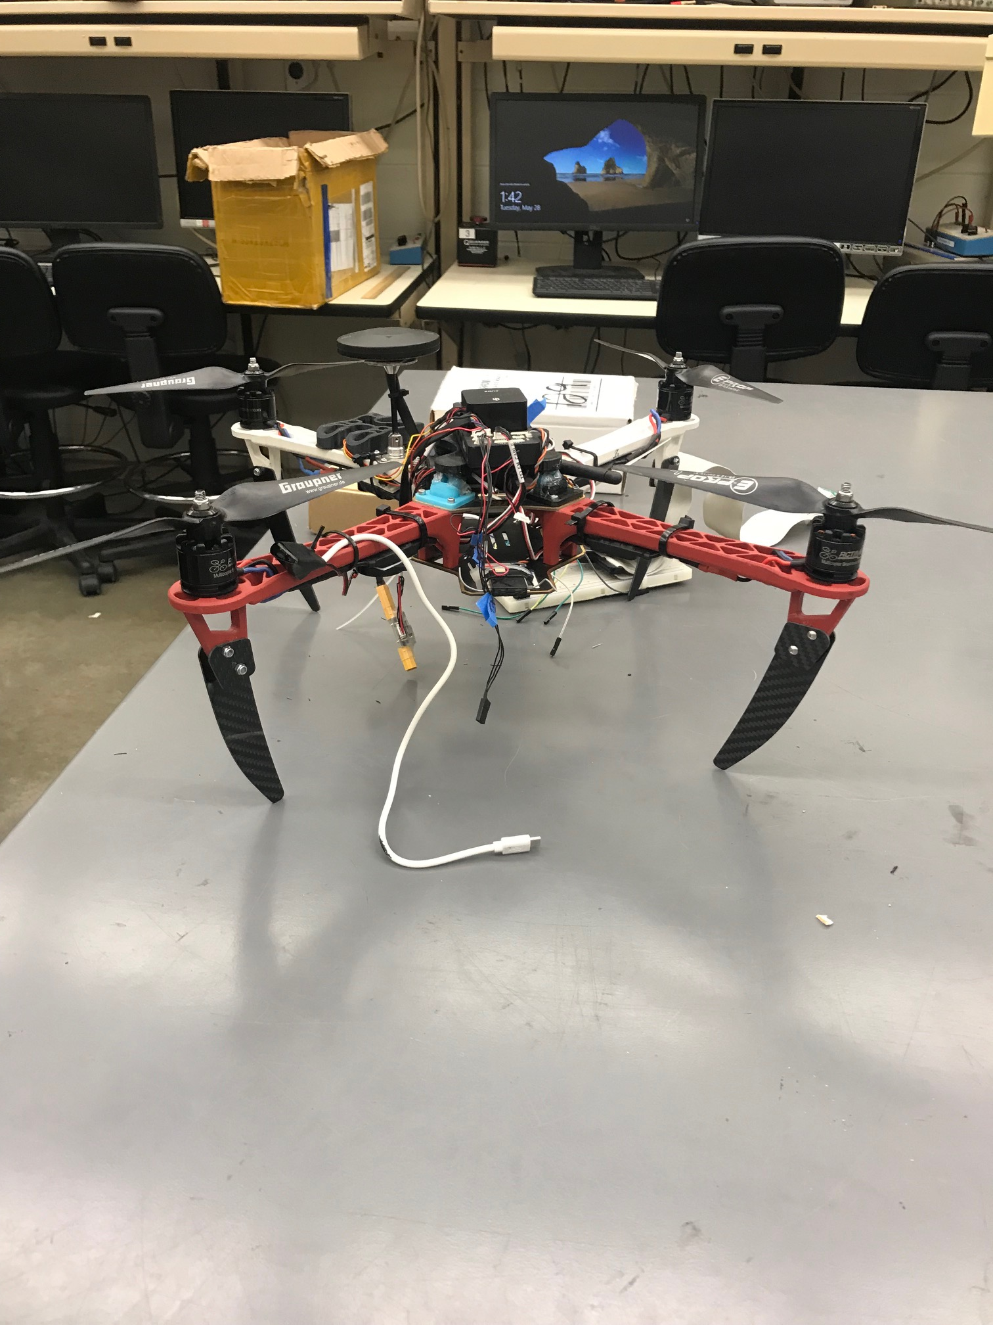

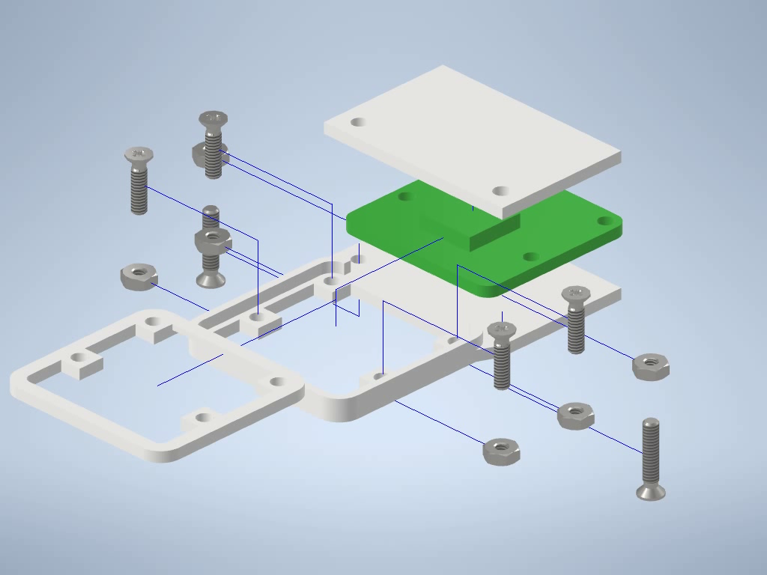
Proposed Testing and Hardware
3D print a Pi camera mount for the bottom of Pixhawk frame
Pi camera detection of AruCo marker X, Y, and Z axes testing
Maximum position range of a Pi Camera marker lock will be tested
Time for marker lock will also be tested

Slide 10
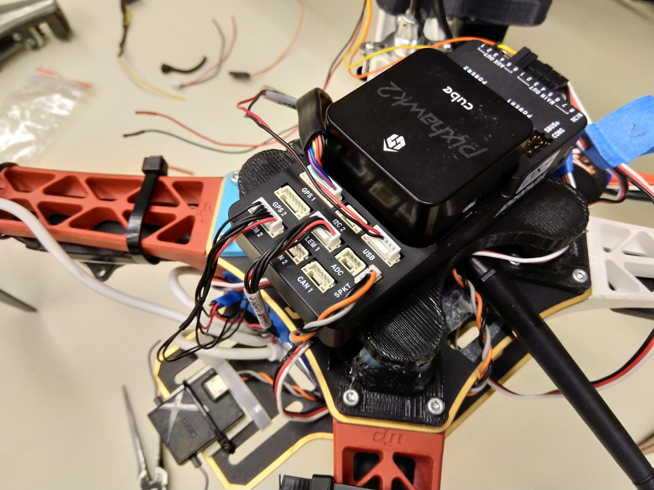
LiDAR and GPS

Slide 11
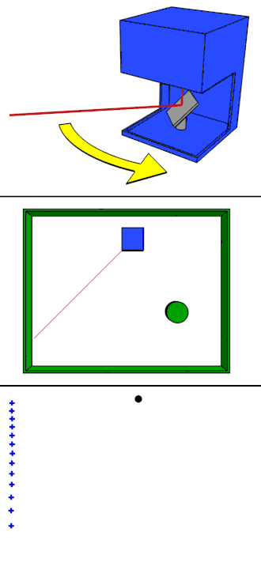
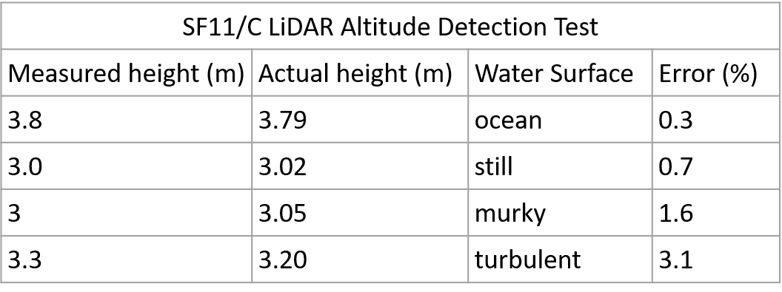
LiDAR Completed
SF11/C LiDAR
Light Detection and Ranging uses measured wavelength of reflected light to calculate distance
SF/11 (Current LiDAR):
  Error bellow 3.5% for all tests
  Results within desired parameters of 6 cm
Read rate of 20Hz permits integration with GPS provided altitude measurements

Slide 12
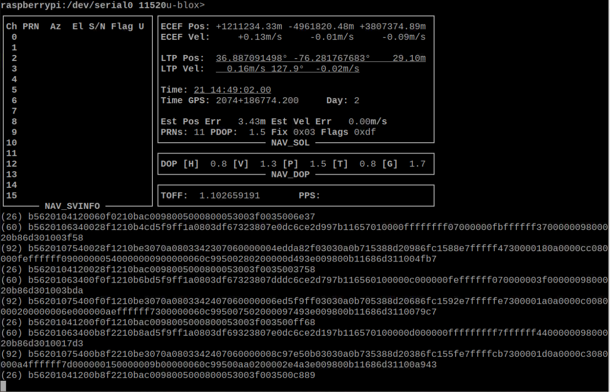
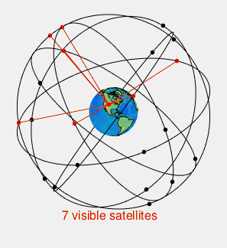
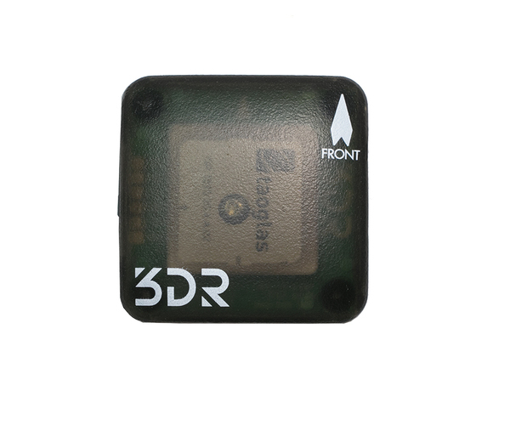
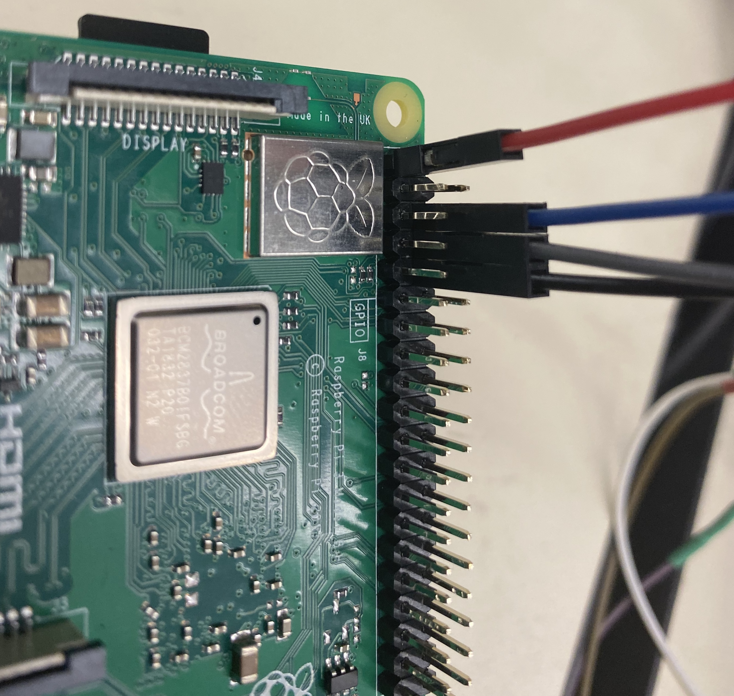
GPS Completed
A test GPS has been fully implemented into the raspberry pi. With this test GPS we have been able to Verify and Validate:
  The pi’s ability to interface with GPS
  The GPS ability to obtain a fix
  The pi’s ability to interpret NMEA data
  The pi’s ability to convert NMEA data

Slide 13
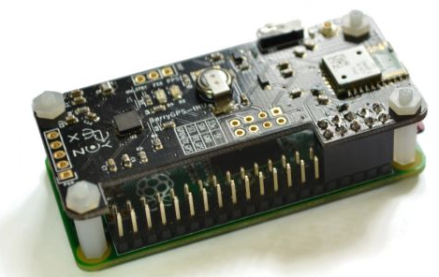
Proposed GPS
Berry GPS-IMU V3 will be connected to Raspberry Pi
Use same libraries as the test-GPS to acquire data
Turn off the GPS once initial position is established
Convert IMU and LiDAR data to GPS (NMEA) format
Have Pi use GPS/IMU data to provide spoof signals to Pixhawk
http://ozzmaker.com/berryGPS-berryGPS-imu-quick-start-guide/

Slide 14
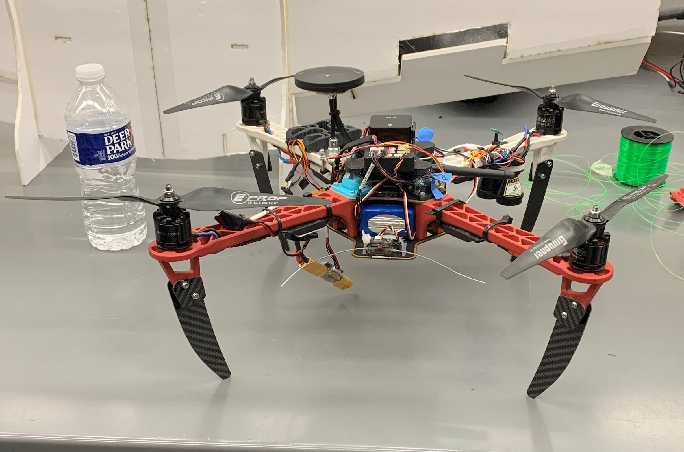
Summary

Slide 15
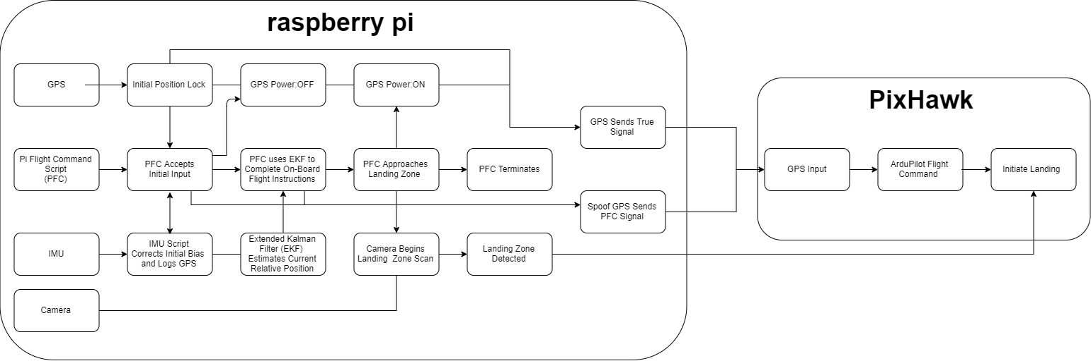
Sensor Integration Proposed Methods

Slide 16
